Slide 1
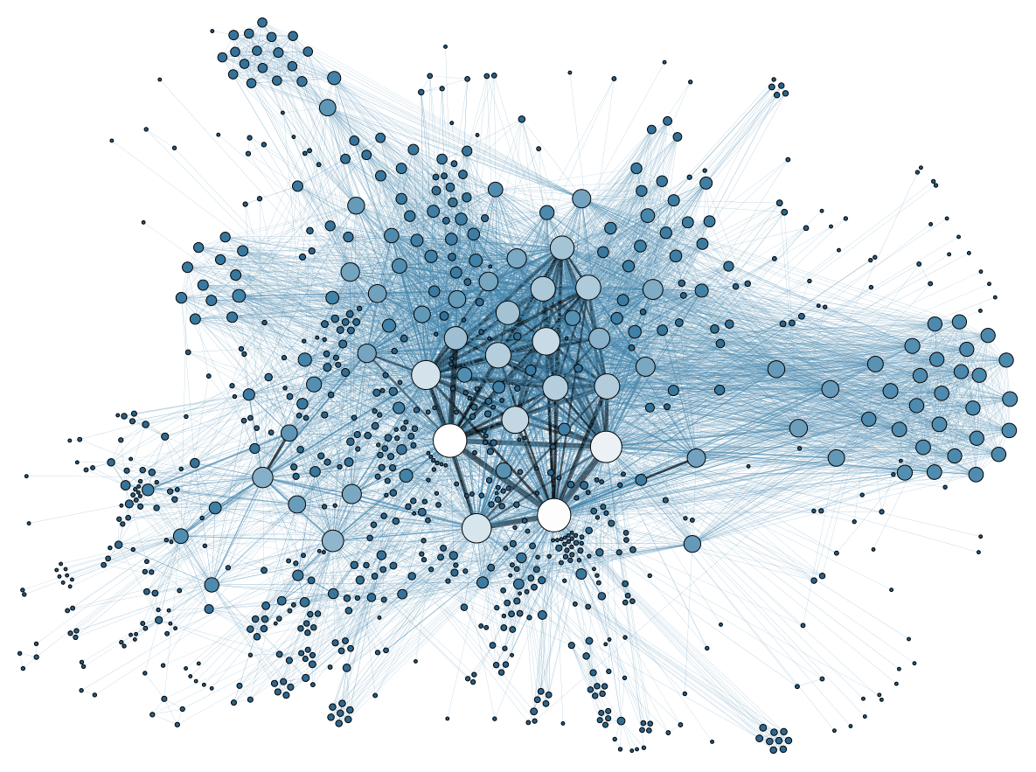
Unsupervised Clickstream Clustering for User Behavior Analysis
Gang Wang, Xinyi Zhang, Shiliang Tang,
Haitao Zheng and Ben Y. Zhao
UC Santa Barbara
gangw@cs.ucsb.edu

Slide 2
Online Services Are User-Driven
Huge user populations in today’s online services
Facebook (1.6 Billion), Twitter (332 Million)
Yelp (69 Million), Redddit (36 Million), Yik Yak (3.6 Million)
Users are the primary content contributors
User generated content (videos, pictures, messages)
User activities, social connections
Online services are increasingly dependent on well-behaved users

Slide 3
Understanding Online Users
An increasing need to understand user behavior
What are the prevalent types of user behaviors?
How to identify and understand these behaviors?
Do user behaviors evolve/change over time?
…...
Job seekers
Happily Employed
Job hoppers
Recruiters
Are there undesired behaviors (job scams)?
Is the company doing well?
Can we predict key trends in professional/stock market?

Slide 4
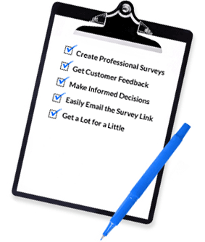
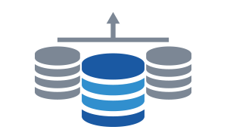
Behavior Analysis Is Challenging in large online services
User interviews and surveys
Good at answering “why,” but time-intensive
High cost, does not scale (to millions of people)
Our approach: analyze detailed user logs
Examine how users “click” in online services
Identify and understand previously unknown behaviors
Need a scalable, data-first approach to understand user behavior

Slide 5
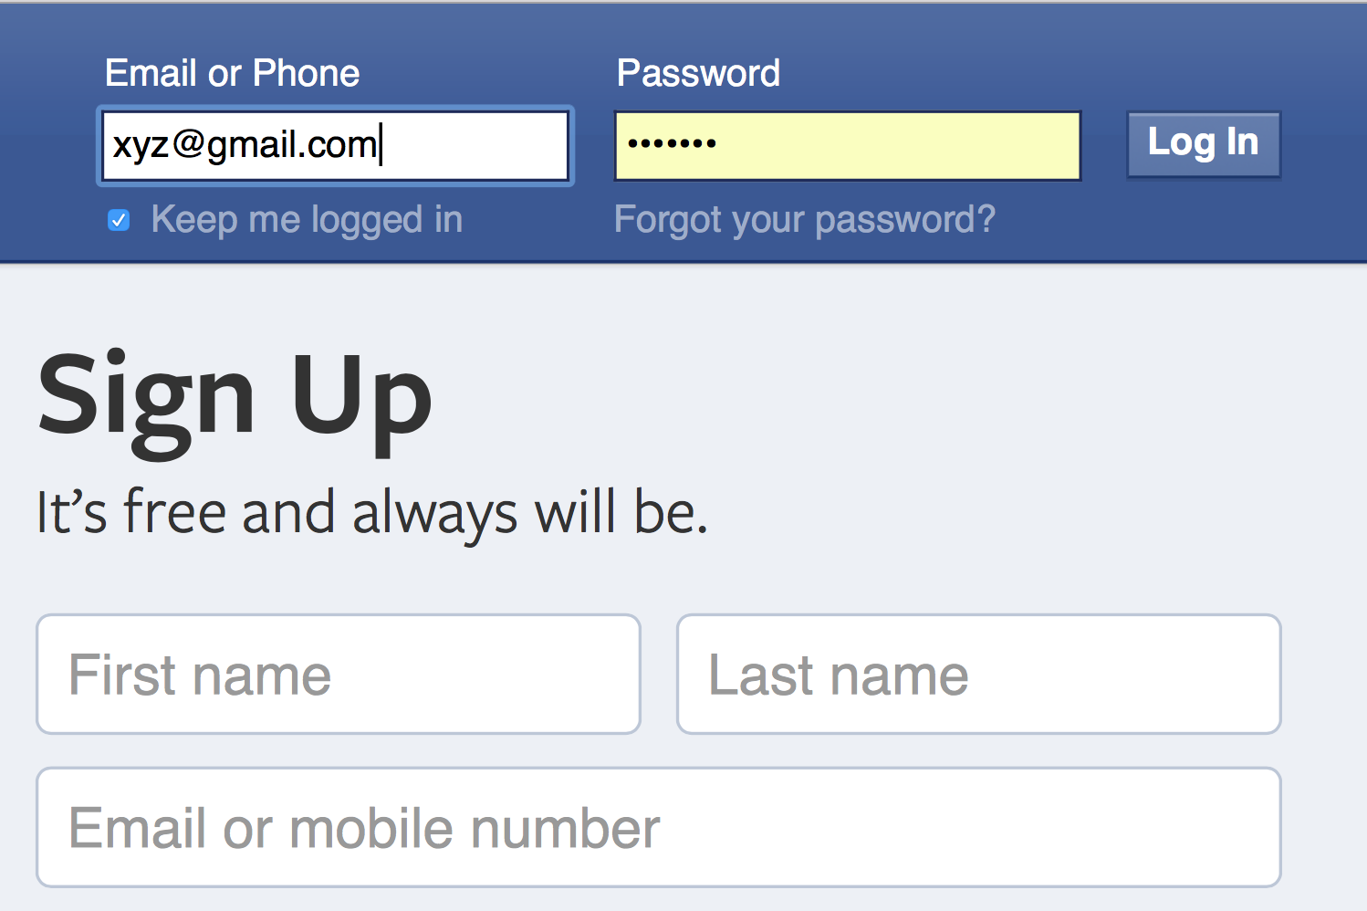
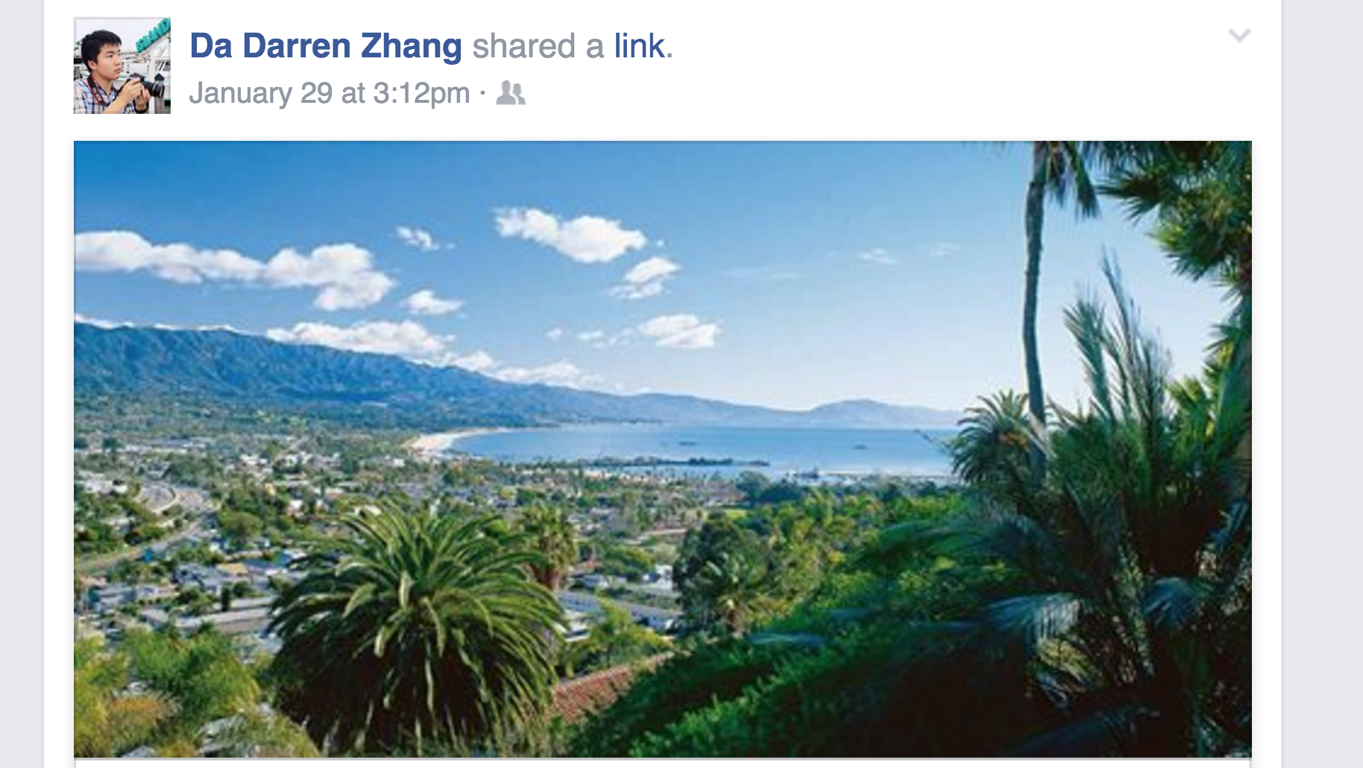
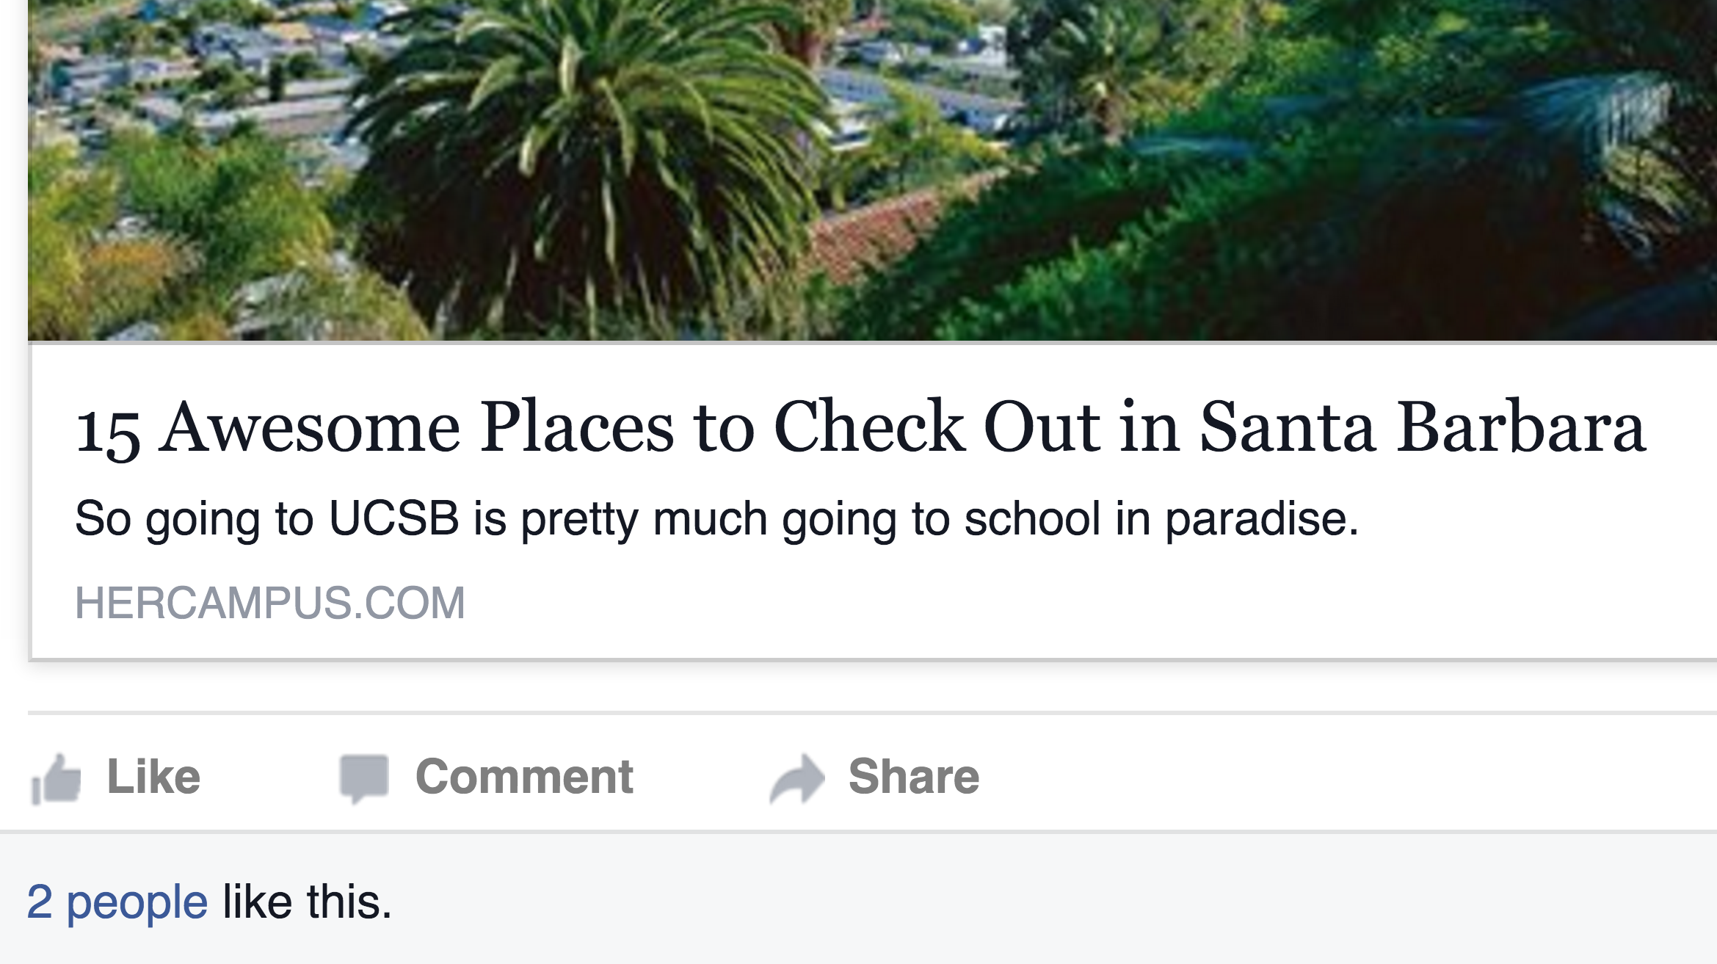
Clickstream: You are How You Click
Clickstream analysis for behavior modeling
Clickstream: a sequence of click events (and time gaps)
Suitable for identifying fine-grained user behaviors
Our Goals
Identify natural clusters of user behavior based on clickstreams
Extract semantic meanings for captured behaviors
Scalable for large online services
10s
5s
Login
Photo
Like

Slide 6
Outline
Introduction
Clickstream User Behavior Model
Clickstream Similarity Graph
Iterative Feature Pruning
Real-World Evaluation
Conclusion

Slide 7
User Behavior Model
Key intuitions
Users naturally form clusters
More fine-grained user clusters are hidden within big clusters
All users
Active
Generating Content
Inactive
Consuming Content
Automatically capture hierarchical structure of behavior clusters

Slide 8
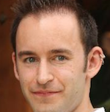
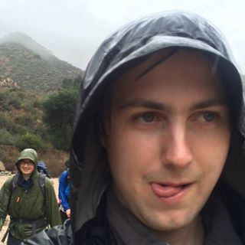
Clickstream Similarity Graph
Identify user clusters that share similar behaviors
Map user’s clickstreams to a similarity graph
Clickstreams are nodes
Edge weighted by the similarity of clickstreams
Graph partitioning to capture clusters of users
Each cluster represents certain type of click/behavior pattern
0.7
0.1
0.75
Similarity: common subsequence (count)
Cosine Distance
S₁= AAB
S₂= BBC
ngram₁= {A(2), B(1), AA(1), AB(1), AAB(1)}
ngram₂= {B(2), C(1), BB(1), BC(1), BBC(1)}
V₁=(2,1,0,1,1,0,0,1,0)
V₂=(0,2,1,0,0,1,1,0,1)

Slide 9
Hierarchical Clustering with “Iterative Feature Pruning”
Partition a clickstream similarity graph
Identify fine-grained clusters within big clusters
Select features to interpret each cluster
Full Graph
Start from a full similarity graph
Partition the graph in to k clusters
Select distinguishing features for each new cluster
Prune top features, re-compute similarity graph, detect sub-clusters
Iteratively repeat 2-4 for new graphs, terminate if no clear cluster structures
No pre-defined features / constraints
Consider all sub-sequences in clickstream (ngram)
F_{x}
F_{y}
Active
Inactive
Based on clustering quality convergence (modularity)
Posters
Viewers
Inactive
……
Abusers
……

Slide 10
Iterative Feature Pruning
What features need to be pruned?
Highly distinguishing features for each cluster
Feature selection: maintain feature semantic meanings
Matrix Factorizations or Neural Networks not applicable
Select raw “features” statistically
Rank features based on Chi-square statistics
(i.e., how strongly a feature is associated with a cluster)

Slide 11
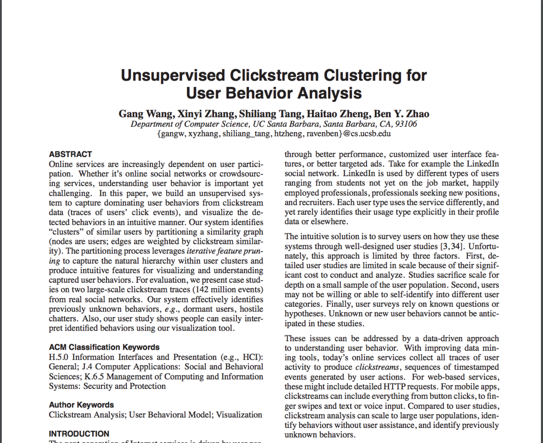
Outline
Introduction
Clickstream User Behavior Model
Real-World Evaluation
Whisper: anonymous social network
Renren: Chinese Facebook
Conclusion

Slide 12
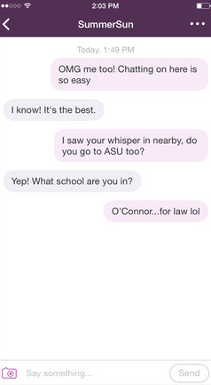
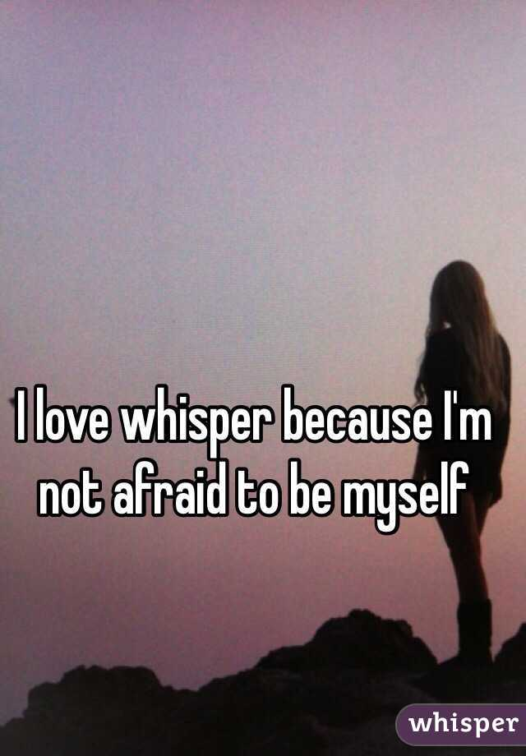
“Whisper” Social Network
Whisper app
Anonymous social network
Express thoughts freely without fear
20 Million users as of 2015
Clickstream dataset
Obtained from Whisper Inc.
100K users, 142M clicks
33 types of click events
Oct. - Nov. in 2014
IRB APPROVED
“Heart” or “Reply” the message, or “Chat” privately

Slide 13
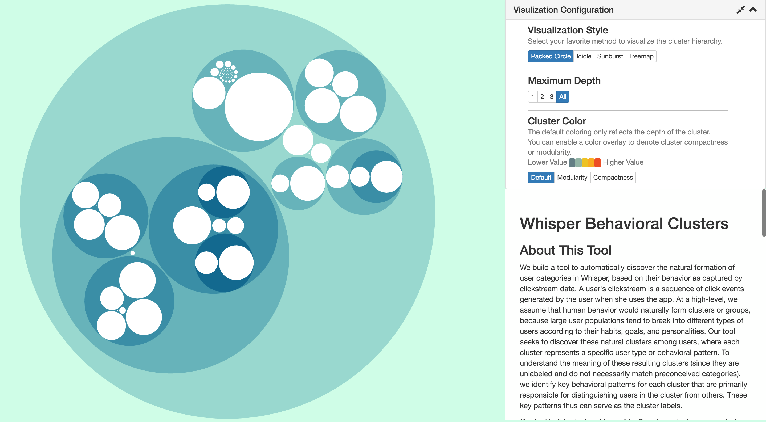
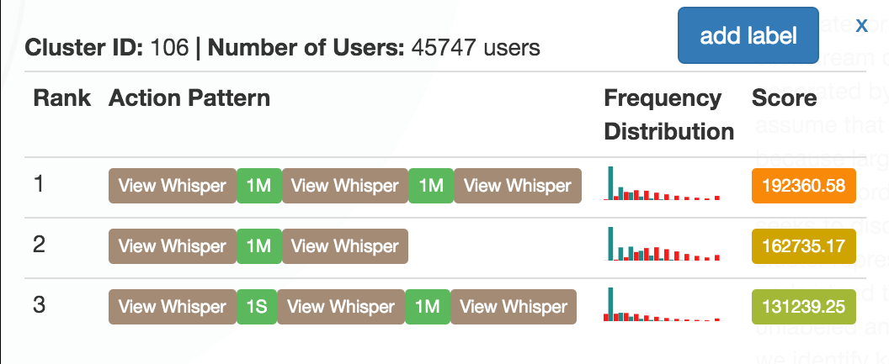
Visualization: Whisper Clusters Based on 100K users, 142M clicks
Hierarchical Clusters
High-level behavior categories
Secondary detailed behaviors
Case Study 1: Users who block others in chat
70% users spend >10% of clicks on blocking
Selected features in this cluster (subsequences in clickstreams)
User Study
Do these clusters contain semantic meanings?
User study to label clusters (15 users)
Users can easily extract semantic labels (95.5%)
A high consistency among user generated labels

Slide 14
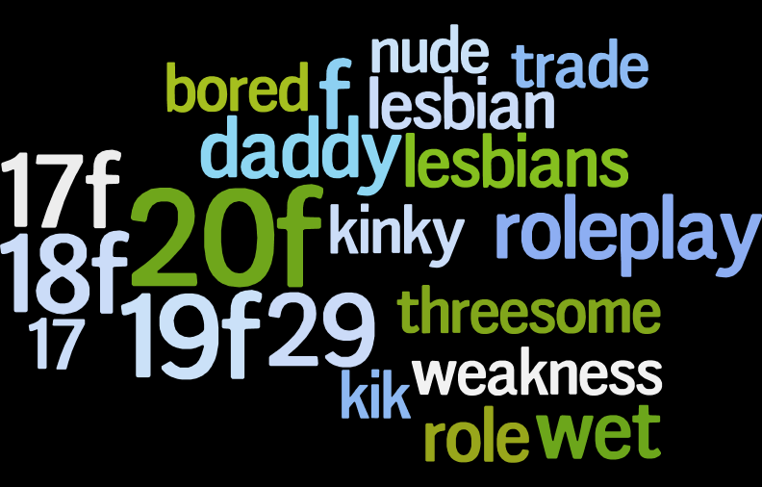
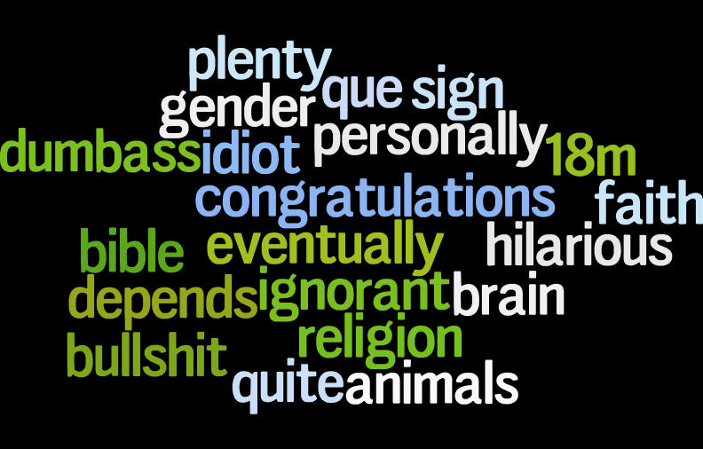
Why Do Users Block Others?
Whisper messages highly related to sexting
Attract unwanted chatters or harassment
Bidirectional blocking: significantly higher inside cluster
Users get offended for being blocked → block back (quickly)
Inside Cluster
Outside Cluster
Strong sign of hostile behavior during private chat
Necessary intervention is needed

Slide 15
Behavior Changes Over Time? Case #2: Inactive Users
Inactive Cluster
Second largest cluster
Users who don’t actively use the app

Slide 16
Tracking Behavior Changes
Users within the inactive cluster
Dormant: zero active actions
Semi-dormant: only login occasionally
Hypothesis: users in inactive cluster will migrate to “dormant” cluster over time
Semi-dormant
Dormant
Analyzing user migration
Split clickstream data into three snapshots, 2-week each
Compare user behavior clusters across snapshots

Slide 17
Predicting User Dormancy
Users turning dormant within adjacent snapshots
Dormant users are likely to remain dormant (94%)
Semi-dormant users are more likely to turn dormant (17% vs. 1%)
All Others
804/71903 (1%)
Semi-dormant
2026/11773 (17%)
Predict user dormancy by monitoring the inactive cluster
Implement necessary interventions to retain users
Dormant
15873/16872 (94%)
Snapshot-A
Oct.28-Nov.12 2014
Snapshot-B
Nov.13-Nov.26 2014
Ongoing: identify “paths” of behavior changes
“What makes a user turn into a bully/troll?”

Slide 18
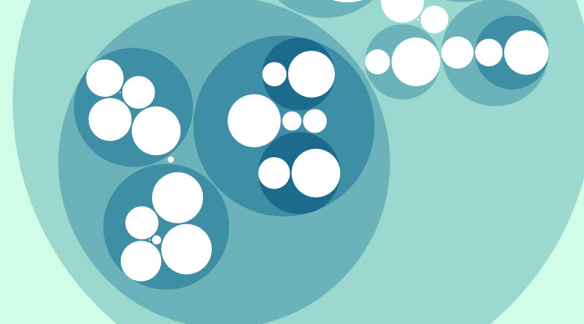
Conclusion & Future Work
Clickstream behavior model is a powerful tool
Unsupervised: no prior assumptions
Interpretable: easy to extract semantic features
Scalable: for large user populations
Ongoing and future work
Understand longitudinal user behavior change over time
Fast graph partitioning and snapshot analysis
Understand cyberbully/trolling in online communities
Demo/code: http://sandlab.cs.ucsb.edu/clickstream/

Slide 19
Thank You
Demo: http://sandlab.cs.ucsb.edu/clickstream/

